Slide 1

Employee Management System (EMS)

Slide 2
OUR TEAM
M.Aryan
U.manish
Sai kiran

Slide 3
Introduction
This project presents a comprehensive SQL database designed for an Employee Management System (EMS). It covers essential entities and relationships needed to manage employee information, job departments, payroll, salaries, bonuses, leaves, and qualifications. The database includes tables for employees, job roles, departments, payroll transactions, leave records, salary/bonus details, and qualifications.
Through carefully crafted SQL queries, the project solves real-world HR and business questions, such as identifying top-paid employees, analyzing salary expenditure, tracking employee leaves, understanding departmental structures, and monitoring promotions and qualifications. This makes it a practical foundation for analytics and decision-making in workforce and payroll management.

Slide 4
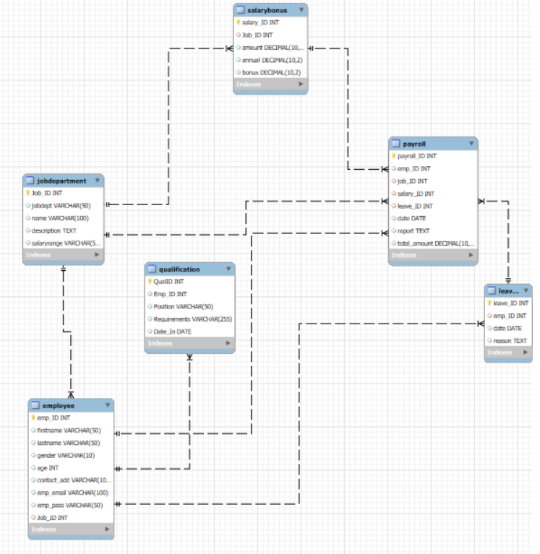
ER DIAGRAM

Slide 5
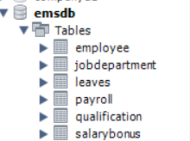
CREATING TABLES
The project begins by creating structured tables for storing employee management data, including information about employees, job departments, payroll, salaries, bonuses, leaves, and qualifications. Primary and foreign keys are used to ensure data integrity and meaningful relationships between different entities such as employees, departments, payroll transactions, and leave records.

Slide 6
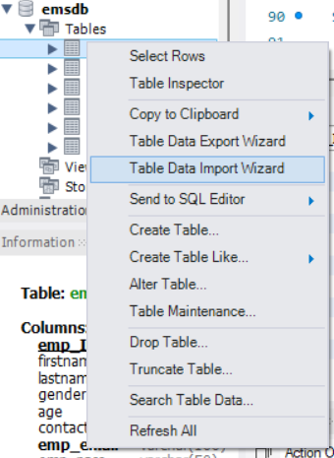
Importing Data Into Tables
Data is imported into tables in an orderly manner using the LOAD DATA INFILE command for bulk data loads from CSV files, ensuring efficient population of large datasets like Employee, Payroll, Leaves, Salary_Bonus, JobDepartment, and Qualification. Additionally, the import wizard option in database management tools provides a user-friendly interface for importing data step-by-step, allowing customization and validation during the import process.

Slide 7
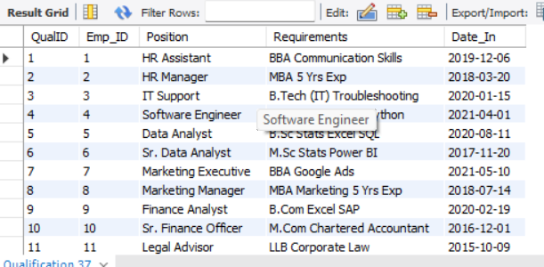
Challenges We Faced
During import of Qualification.csv, some rows had incorrect date formats such as 12-03-22 instead of YYYY-MM-DD. This caused parsing errors.
So then we Converted all date fields into the YYYY-MM-DD format using SQL’s STR_TO_DATE() function before import.

Slide 8

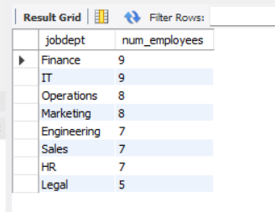
QUERIES
1. EMPLOYEE INSIGHTS
How many unique employees are currently in the system?
SELECT COUNT(DISTINCT emp _ ID) AS total employees FROM Employee;
Which departments have the highest number of employees?
SELECT jd.JobDept, COUNT(e.EmpID) AS NumEmployees
FROM Employee e
JOIN JobDepartment jd ON e.JobID = jd.JobID
GROUP BY jd.JobDept
ORDER BY NumEmployees DESC;

Slide 9
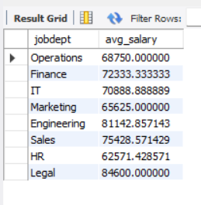
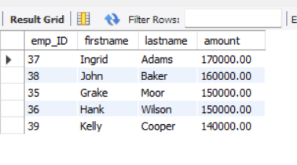
What is the average salary per department?
SELECT jd.jobdept, AVG(sb.amount) AS avg_salary
FROM Employee e
JOIN JobDepartment jd ON e.Job_ID = jd.Job_ID
JOIN SalaryBonus sb ON e.Job_ID = sb.Job_ID
GROUP BY jd.jobdept;
Who are the top 5 highest-paid employees?
SELECT e.emp_ID, e.firstname, e.lastname, sb.amount
FROM Employee e
JOIN SalaryBonus sb ON e.Job_ID = sb.Job_ID
ORDER BY sb.amount DESC
LIMIT 5;

Slide 10

What is the total salary expenditure across the company?
SELECT SUM(sb.amount) AS total_salary_expenditure
FROM SalaryBonus sb;

Slide 11
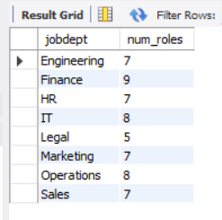
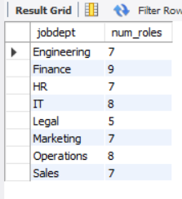
2. JOB ROLE AND DEPARTMENT ANALYSIS
How many different job roles exist in each department?
SELECT jd.jobdept, COUNT(DISTINCT jd.name) AS num_roles
FROM JobDepartment jd
GROUP BY jd.jobdept;
What is the average salary range per department?
SELECT jd.jobdept, AVG(sb.amount) AS avg_salary
FROM SalaryBonus sb
JOIN JobDepartment jd ON sb.Job_ID = jd.Job_ID
GROUP BY jd.jobdept;

Slide 12
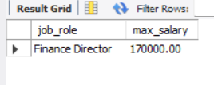
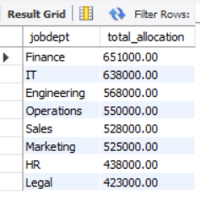
Which job roles offer the highest salary?
SELECT jd.name AS job_role, MAX(sb.amount) AS max_salary
FROM SalaryBonus sb
JOIN JobDepartment jd ON sb.Job_ID = jd.Job_ID
GROUP BY jd.name
ORDER BY max_salary DESC
LIMIT 1;
Which departments have the highest total salary allocation?
SELECT jd.jobdept, SUM(sb.amount) AS total_allocation
FROM SalaryBonus sb
JOIN JobDepartment jd ON sb.Job_ID = jd.Job_ID
GROUP BY jd.jobdept
ORDER BY total_allocation DESC;

Slide 13

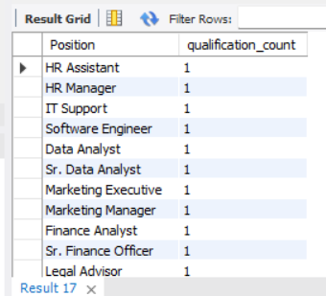
3. QUALIFICATION AND SKILLS ANALYSIS
How many employees have at least one qualification listed?
SELECT COUNT(DISTINCT Emp_ID) AS employees_with_qualifications
FROM Qualification;
Which positions require the most qualificationsa?
SELECT Position, COUNT(*) AS qualification_count
FROM Qualification
GROUP BY Position
ORDER BY qualification_count DESC;

Slide 14
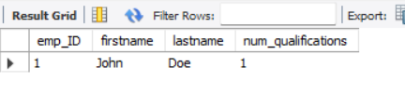
Which employees have the highest number of qualifications?
SELECT e.emp_ID, e.firstname, e.lastname, COUNT(q.QualID) AS num_qualifications
FROM Employee e
JOIN Qualification q ON e.emp_ID = q.Emp_ID
GROUP BY e.emp_ID, e.firstname, e.lastname
ORDER BY num_qualifications DESC
LIMIT 1;

Slide 15

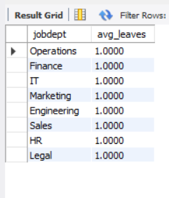
4. LEAVE AND ABSENCE PATTERNS
Which year had the most employees taking leaves?
SELECT YEAR(Date) AS LeaveYear, COUNT(DISTINCT Emp_ID) ASEmployeesOnLeave
FROM Leaves
GROUP BY YEAR(Date)
ORDER BY EmployeesOnLeave DESC;
What is the average number of leave days taken by its employees per department?
SELECT jd.jobdept, AVG(leave_count) AS avg_leaves
FROM (
SELECT e.emp_ID, e.Job_ID, COUNT(l.leave_ID) AS leave_count
FROM Employee e
LEFT JOIN Leaves l ON e.emp_ID = l.emp_ID
GROUP BY e.emp_ID, e.Job_ID
) AS emp_leaves
JOIN JobDepartment jd ON emp_leaves.Job_ID = jd.Job_ID
GROUP BY jd.jobdept;

Slide 16


Which employees have taken the most leaves?
SELECT e.emp_ID, e.firstname, e.lastname, COUNT(l.leave_ID) AS total_leaves
FROM Employee e
JOIN Leaves l ON e.emp_ID = l.emp_ID
GROUP BY e.emp_ID, e.firstname, e.lastname
ORDER BY total_leaves DESC
LIMIT 1;
What is the total number of leave days taken company-wide?
SELECT COUNT(*) AS total_leave_days
FROM Leaves;

Slide 17
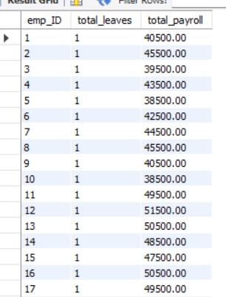
How do leave days correlate with payroll amounts?
SELECT e.emp_ID, COUNT(l.leave_ID) AS total_leaves, SUM(p.total_amount) AS total_payroll
FROM Employee e
LEFT JOIN Leaves l ON e.emp_ID = l.emp_ID
LEFT JOIN Payroll p ON e.emp_ID = p.emp_ID
GROUP BY e.emp_ID;

Slide 18

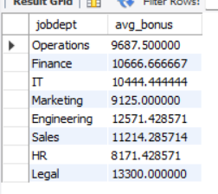
5. PAYROLL AND COMPENSATION ANALYSIS
What is the total monthly payroll processed?
SELECT YEAR(Date) AS Yr, MONTH(Date) AS Mn, SUM(Total_Amount) AS MonthlyTotal
FROM Payroll
GROUP BY YEAR(Date), MONTH(Date)
ORDER BY Yr, Mn;
What is the average bonus given per department?
SELECT jd.jobdept, AVG(sb.bonus) AS avg_bonus
FROM SalaryBonus sb
JOIN JobDepartment jd ON sb.Job_ID = jd.Job_ID
GROUP BY jd.jobdept;

Slide 19


Which department receives the highest total bonuses?
SELECT jd.jobdept, SUM(sb.bonus) AS total_bonus
FROM SalaryBonus sb
JOIN JobDepartment jd ON sb.Job_ID = jd.Job_ID
GROUP BY jd.jobdept
ORDER BY total_bonus DESC
LIMIT 1;
What is the average value of total_amount after considering leave deductions?
SELECT AVG(total_amount) AS avg_net_pay
FROM Payroll;

Slide 20
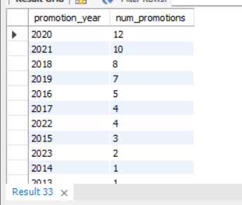
6. EMPLOYEE PERFORMANCE AND GROWTH
Which year had the highest number of employee promotions?
SELECT YEAR(Date_In) AS promotion_year, COUNT(*) AS num_promotions
FROM Qualification
GROUP BY YEAR(Date_In)
ORDER BY num_promotion

Slide 21
CONCLUSION
This project demonstrates how SQL empowers us to transform raw employee management data into actionable business insights. By designing and querying a relational database, we can accurately analyze employee distribution across departments, salary expenditure, bonus allocations, leave patterns, and promotion trends.
These findings guide strategic HR decisions, such as identifying departments with the highest costs, recognizing top-performing employees, and monitoring workforce growth.
Additionally, the process offers valuable hands-on experience with complex SQL techniques—including joins, subqueries, aggregate functions, constraints, cascading updates/deletes, and date formatting—beyond basic SELECT statements.
Ultimately, this analytical approach ensures informed decision-making, supports payroll accuracy, enhances employee satisfaction, and improves organizational efficiency.

Slide 22

THANK YOU

